Slide 1
Car price prediction on AWS
Cloud Computing Project – Group 3
Akhil Bharadwaj
Akshay Verma
Yashwant Bhaidkar

Slide 2
Scope of the project
Car price prediction using the following AWS resources:
AWS S3 bucket for dataset storage,
AWS SageMaker for machine learning, and
AWS EC2 instance to host the Streamlit app for inferencing
We have created a website where you can select various features of a car and it will predict the sales price
The dataset contains car sale price and features and is taken from Kaggle, it has 38,522 observations with 30 variables.
Deliverable: Website that predicts car prices based on features.

Slide 3
Data source
The dataset has 38,522 observations with 30 variables.
This dataset contains car sale prices of used cars, it has been taken from the Kaggle website.
Source:- https://www.kaggle.com/code/jcalvarezj/belarus-used-car-prices-regression-analysis/input
The data set has 30 columns:
[1-5] Manufacturer Name, Model Name, Transmission, Color, Odometer Value
[6-10] Year Produced, Engine Fuel, Engine Has Gas, Engine Type, Engine Capacity
[11-15] Body Type, Warranty, State, Drivetrain, Price in USD
[16-20] Is Exchangeable, Location, Number of Photos, Upgrade Count, Duration Listed
[21-30] Feature 0 to Feature 9 (Categorical)

Slide 4
Features that are implemented
Data Storage on AWS S3 Bucket
Storing dataset for input to AWS SageMaker
Model training using AWS SageMaker
Developing ML model by fetching data from S3 bucket and using xgboost regression in SageMaker for predictions. Achieved R score of 0.90
EC2 instance for Streamlit app
Using EC2 for data cleaning pipelines and output generations. Hosting Streamlit app with Model on EC2 instance as well.

Slide 5
Outcomes
There are two ways to get the outcome:
1) Real-time result for the single input
User will get the estimated price for the old car(based on real time input)
2)Excel based request for the multiple outputs
User can submit multiple inputs through a file and get the results collectively
3)Better price prediction for the Vintage cars
developing the model which will give attention to the Vintage car prediction.

Slide 6
Logical Architecture Diagram
Streamlit
Website
(For inferencing on user input)
User input from the UI
AWS EC2 instance
User
User input
Output price predicted from model
Model response​
Model response
AWS SageMaker
(Model Training, Saving and Evaluation)
AWS S3 Bucket
Input
Saved model
Hosted on
Dataset (Train and Test)

Slide 7
Data flow diagram
Pipelines for Data Cleaning
(Removing Null/empty values, handling outliers)
Regression Model building Using training data
(XGBoost, Random Forest)
Dataset
(CSV Format)
Feature Engineering
Price prediction on test data

Slide 8
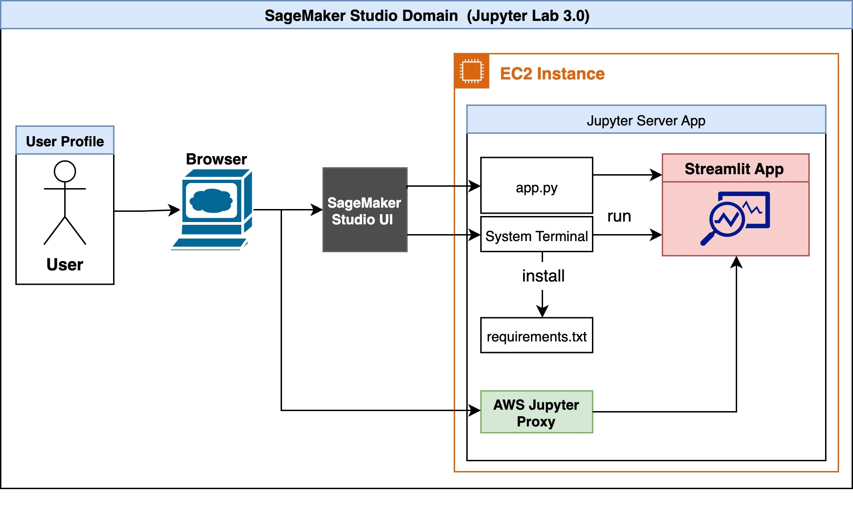
AWS SageMaker
In our Cloud Computing project, we leverage the power of AWS services to create a sophisticated Car Price Prediction system. At the heart of our machine learning pipeline is Amazon SageMaker, a fully managed service that enables us to build, train, and deploy machine learning models at scale.
Amazon SageMaker's integration with Streamlit simplifies the development and presentation of machine learning (ML) model applications. Streamlit, an open-source Python library, enables effortless creation and sharing of user-friendly web apps for ML and data science. Leveraging the integrated development environment (IDE) of Amazon SageMaker Studio, we can seamlessly build, run, and host Streamlit web apps within the same environment used for model development, ensuring security and reproducibility.

Slide 9
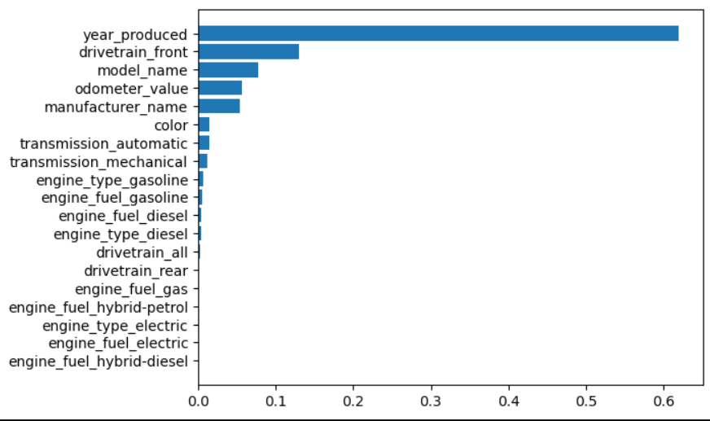
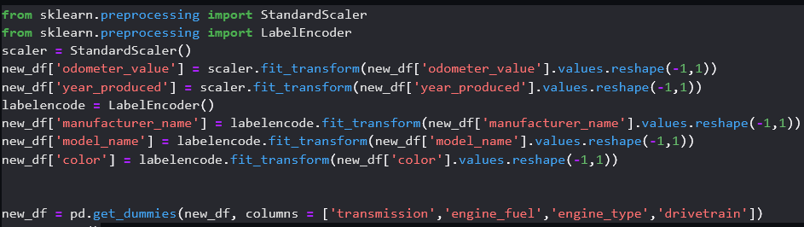
Data scaling, Encoding and feature importance
Standard Scaling label Encoding and one hot encoding
Feature Importance

Slide 10
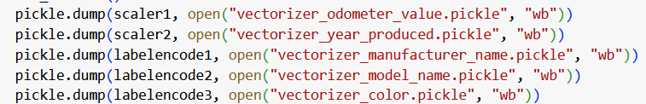

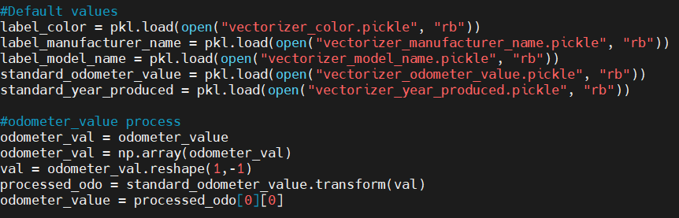
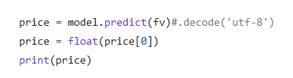
Processing user data and model deployment
Creating pickle file for scaling and encoding
Model predictions using deployed model

Slide 11
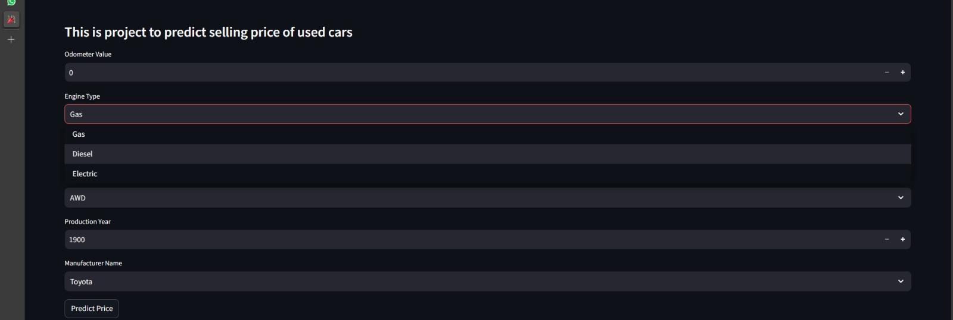
Streamlit
Streamlit serves as the ideal companion to our machine learning (ML) model integration, offering a straightforward approach to creating user-friendly web interfaces.
With a simplified Python scripting paradigm, Streamlit allows us to effortlessly design an intuitive interface for our car price prediction application. The interface has input features, comprising number input boxes and select boxes, providing users with a streamlined way to input car specifications.
The addition of a dedicated "Predict Price" button enhances user interaction, initiating the model's inference process. Upon user input, our ML model processes the features and generates a predicted car price, creating a seamless and interactive experience for users exploring the predictive capabilities of our system.
Streamlit's simplicity accelerates the development of this user interface, making it a powerful tool for data scientists to showcase their ML models.

Slide 12
References
https://aws.amazon.com/blogs/machine-learning/build-streamlit-apps-in-amazon-sagemaker-studio/
http://52.205.183.224:8502

